Slide 1






ICEBERG: Imagery Cyberinfrastructure and Extensible Building Blocks to Enhance Research in the Geosciences
Heather Lynch (Department of Ecology & Evolution/Institute for Advanced Computational Science, Stony Brook University)
Shantenu Jha (Department of Electrical and Computer Engineering, Rutgers University)
Vena Chu (Department of Geography, University of California Santa Barbara)
Mike Willis (Department of Geological Sciences, University of Colorado Boulder)
Mark Salvatore (Department of Physics and Astronomy, Northern Arizona University)

Slide 2

Opportunity
^
Science Challenge:
Petabytes of high-resolution satellite imagery
New analytical tools (e.g., machine learning)
High performance and distributed computing resources
+
+
=
Revolution in imagery-enabled science
Rapid rise in the use of sub-meter spatial resolution imagery for polar science
Many pilot demonstrations but few “at scale”
What’s the barrier to scaling up early successes in imagery-enabled science? Barriers to the flow of data, limited experience with HPDC systems, reliant on commercial software that is difficult to parallelize due to licensing issue
The research objective of this project is to understand the biological, geological, and hydrological functioning of the polar regions at spatial scales heretofore beyond the reach of individual PIs, and to develop tools for imagery-enabled science that can be applied globally.

Slide 3
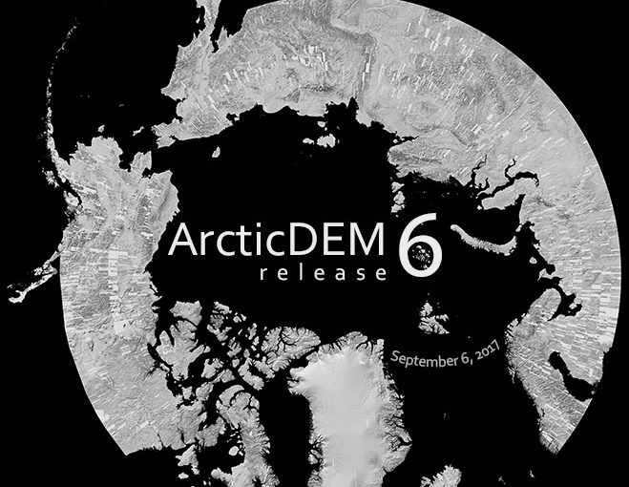
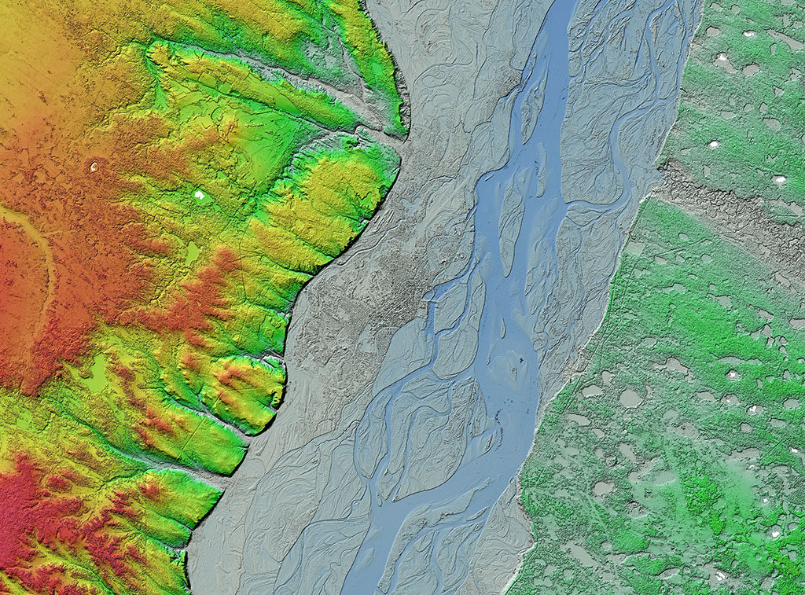
Yakutsk on the Lena River, Siberia
High resolution terrain data is now available for 97.4% of the Arctic. (Source: PGC)
Images and figures courtesy of the Polar Geospatial Center

Slide 4
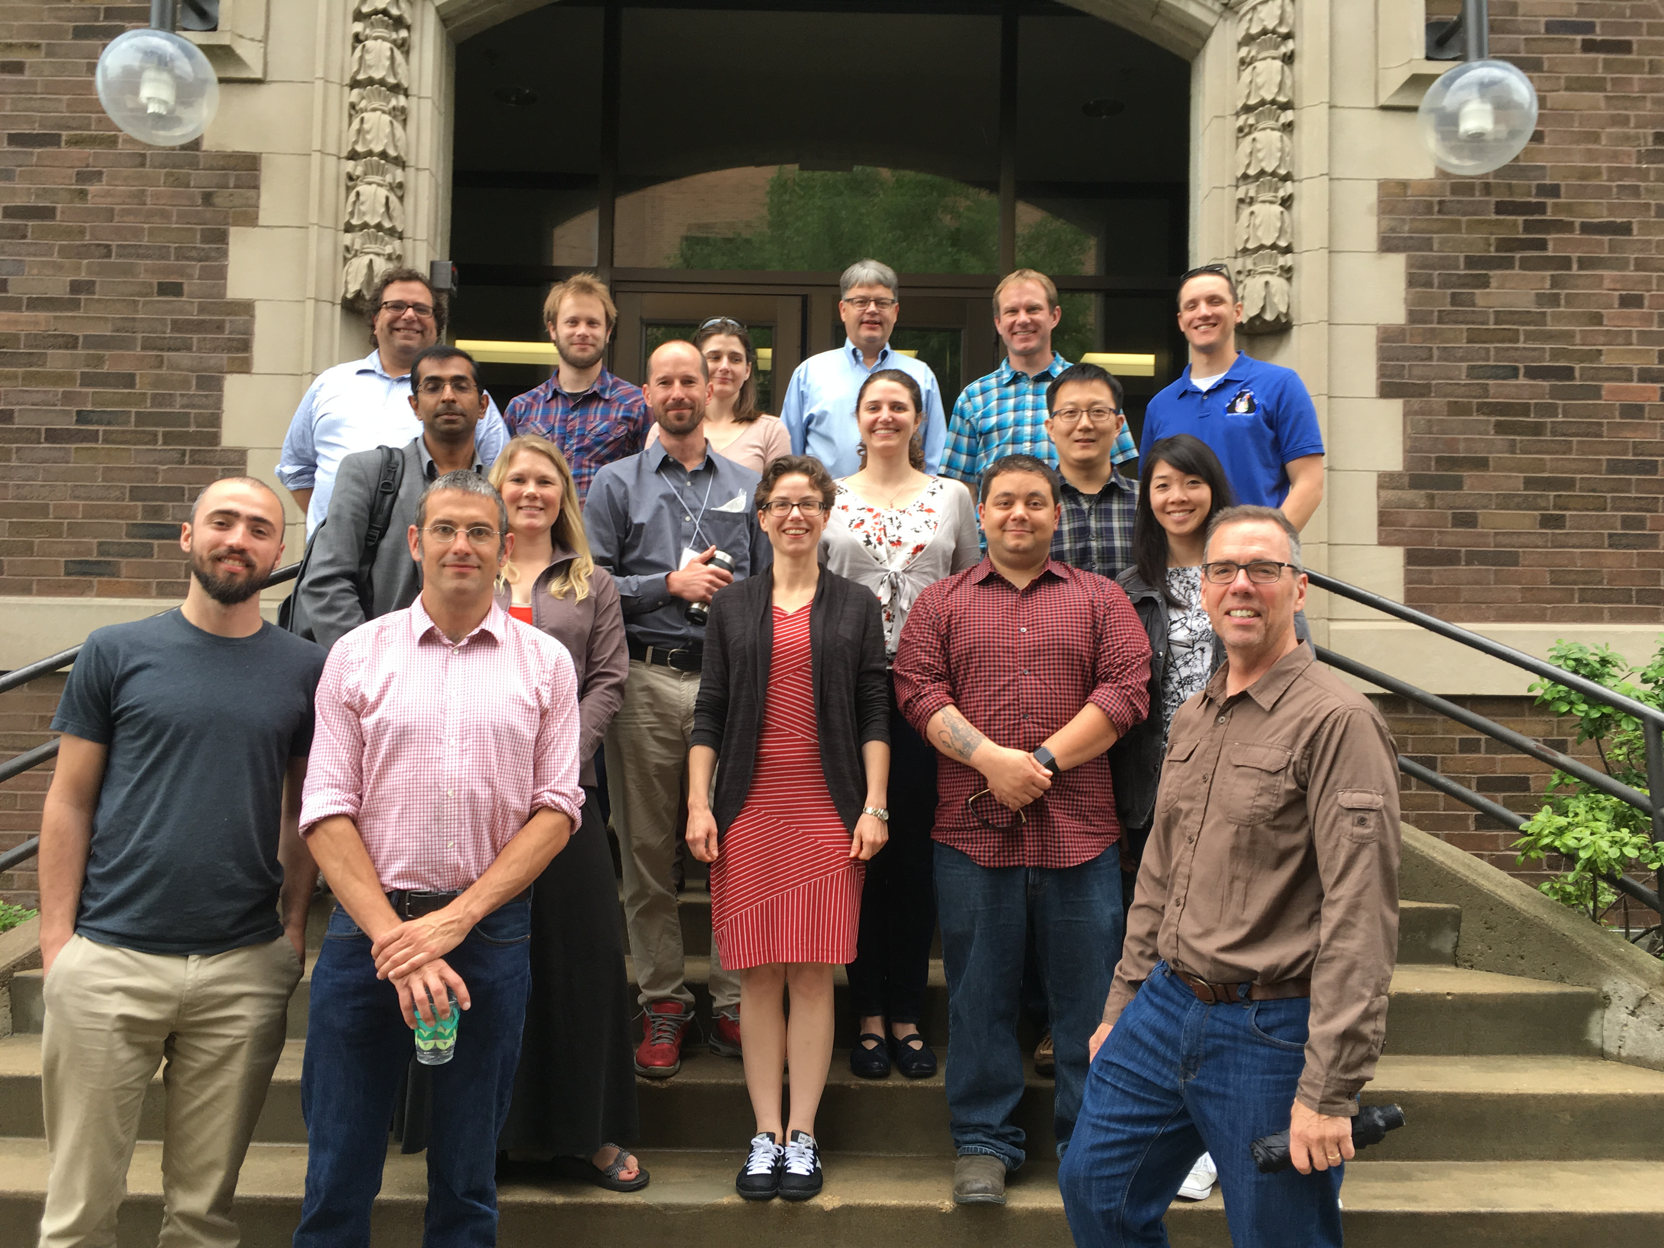

‘horizon scan’ style discussion to identify the most critical bottlenecks (current or near-term) for the effective use of polar imagery across the polar science community
Lessons learned*:
(1) Imagery transfer a major barrier to large-scale analysis
(2) Many analysis methods reliant on proprietary software difficult (or too expensive) to parallelize
(3) Many boutique solutions but few “production grade” pipelines for scaling up techniques demonstrated in smaller pilot projects
(4) Entry barrier to moving to HPC too high for many in the community
* Shared themes with the Pangeo presentation Sept. 28

Slide 5
Examples of imagery-enabled geosciences to be extended by the proposed CI development.
Identifying photosynthetic microbial colonies in the McMurdo Dry Valleys using Worldview-based Normalized Difference Vegetation Index (NDVI).

Slide 6
Examples of imagery-enabled geosciences to be extended by the proposed CI development.
Automated detection of pack-ice seals in satellite imagery using deep learning (TensorFlow).

Slide 7
Examples of imagery-enabled geosciences to be extended by the proposed CI development.
Moulin discharge in Greenland classified with high-resolution satellite imagery.

Slide 8
Examples of imagery-enabled geosciences to be extended by the proposed CI development.
Volume changes from the Vavilov Ice Cap calculated by co-registration and differencing of DEMs.

Slide 9
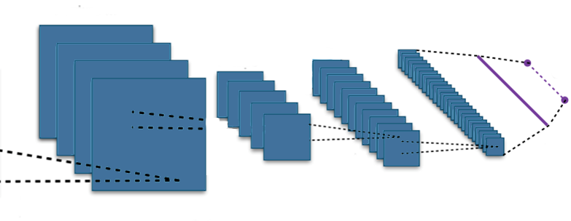
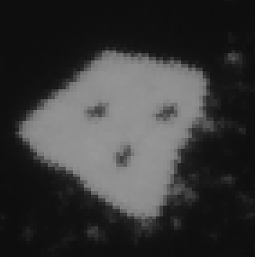
New approach: Satellite + computer vision
Deep learning
Convolutional neural networks (CNN)
Data hungry
Computationally expensive
Feature extraction
Classification
Feature maps
Output
3
Input image
Convolutions
Subsampling
Convolutions
Subsampling
Notes:
- I am dealing with satellite data, which is much easier to get than aerial surveys
When I talk about computer vision now I am really meaning deep learning, which is at the state of the art of nearly every CV application
Deep learning is a branch of machine learning that deals with deep neural networks, artificial neural networks with more than two layers
DNN come in many flavors for different applications,
Classic CNN for natural character recognition, we get an image the number 60 → run a series of convolutions → and hopefully get the integer 60 in the end

Slide 10
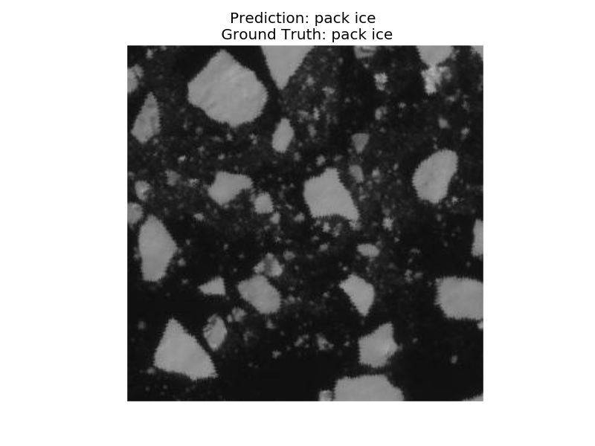
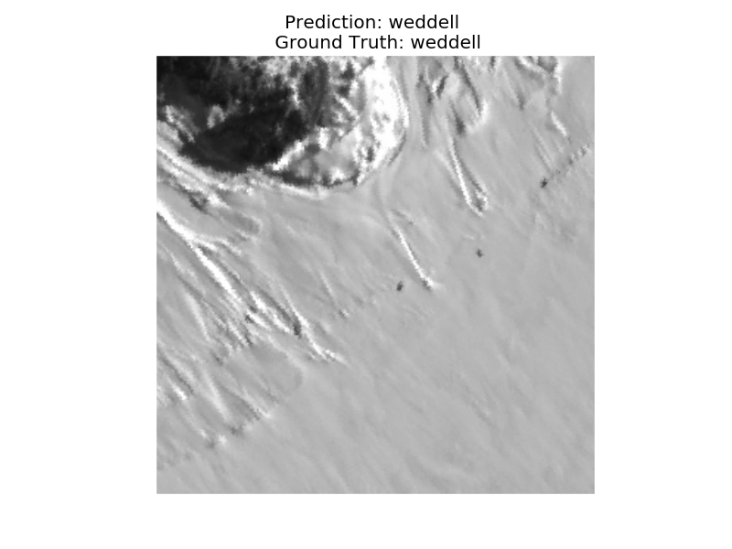
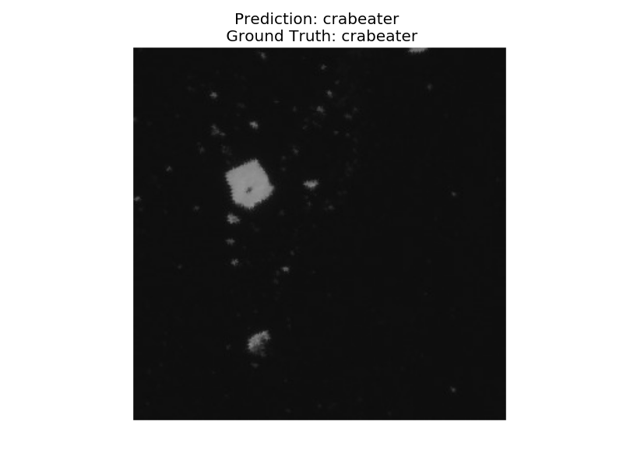
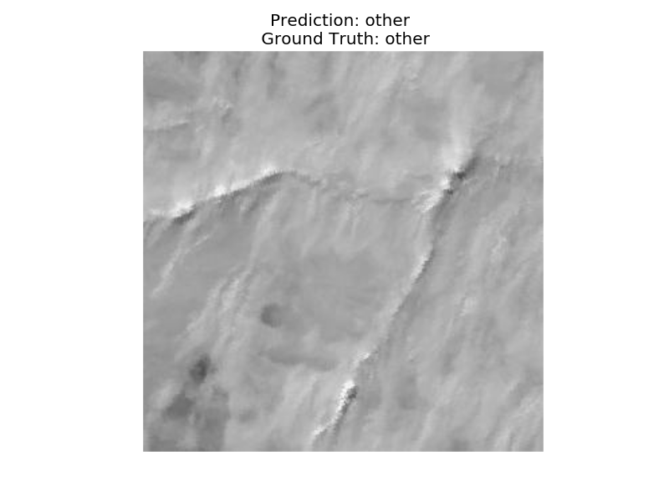
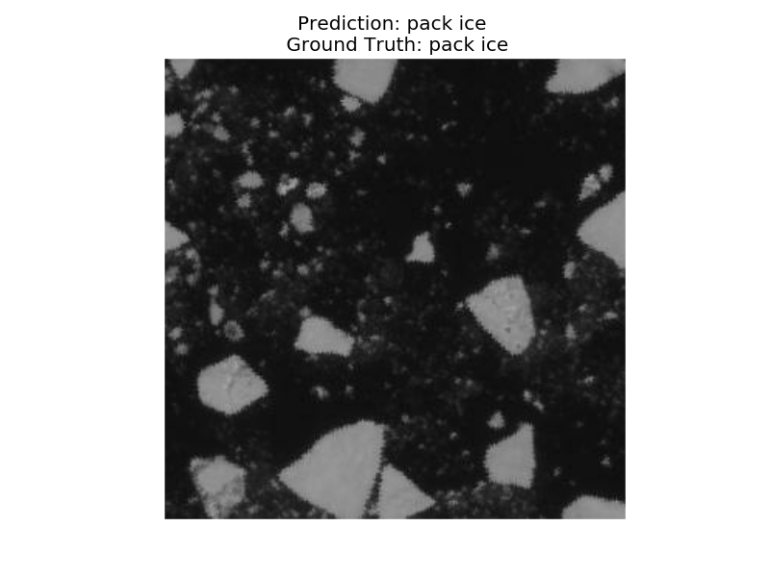
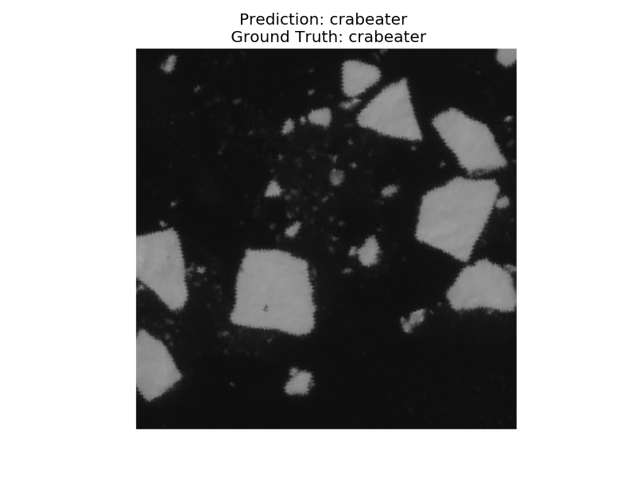
Proof of concept
Inception Resnet-V2 implemented on TensorFlow
95.83 % validation accuracy with across 5 classes:
Crabeater seal
Weddell seal
Emperor penguin
Pack-ice
Other substrate
crabeater

Slide 11
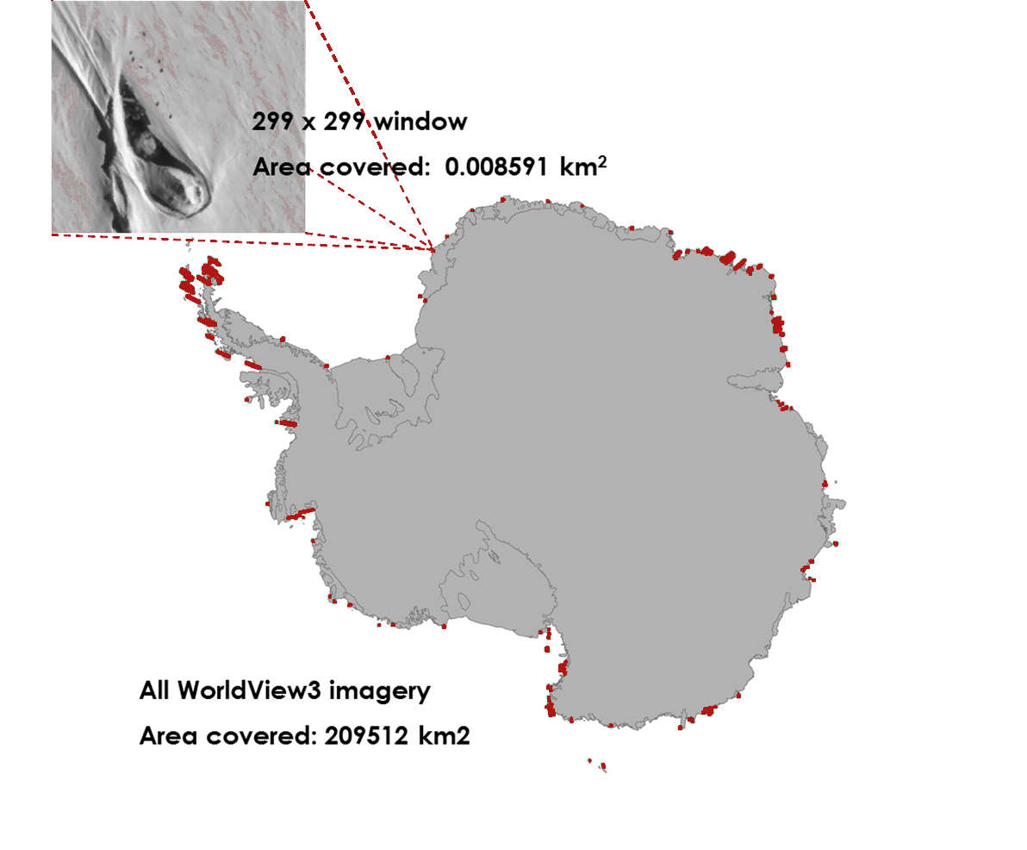
Feasible? Yes - but not easy.
Patch
1 hectare
All WV3 imagery
Area covered: 209512 km²
Number of patches: 2.438 x 10⁶
Running time:
~ 5 days with a single NVIDIA GTX 1080 GPU (2560 CUDA cores, 9 Tflops)
~ 4 hours on SeaWulf (159,744 CUDA cores, 274 Tflops)

Slide 12
Extensible Building Blocks:
Not the tip, but the base of ICEBERG

Slide 13
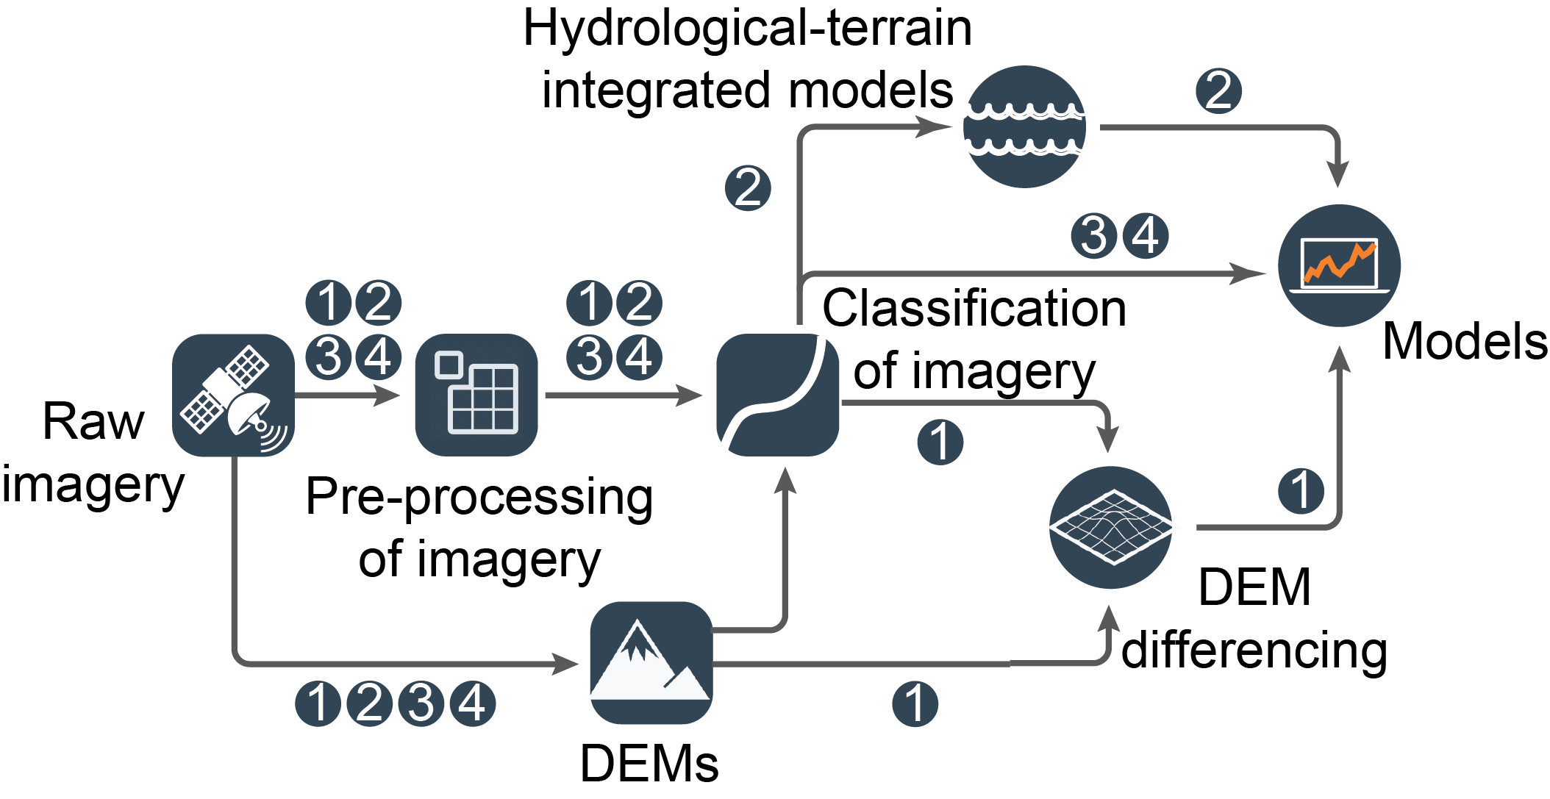
Create pipelines for imagery processing and feature extraction that leverages shared functionality.

Slide 14
CI Development: Local vs Global
Four SD’s because of science problems, but also to ensure there was adequate coverage of requirements and thus prevent “local” solutions
Four SD’s present opportunity and challenge
SD’s different sophistication, and diff. short-medium-long term needs
“Hiding complexity is not the same as exposing simplicity”
Complexity arises from different usage modes (e.g., of the same functionality) and different platforms (e.g., software environment etc)
Thus, tension between too much development and forcing users
Three tracks:
Functionality (F); Usability + Deployment (D); Performance (P)

Slide 15
Work Package Structure
WP1: SD Requirements Capturing
Use Case (UC) requirements via documents: analysis, SRS & propose set of BB
Use Case documents to capture and analyze: (i) Basic Data Services: Input, Output and Management, (ii) Image/data preprocessing, and (iii) Image analysis requirements, (iv)....
WP2: Building Blocks into Libraries and Services (on HPC platforms)
Example Building Blocks: Segmentation, Image Fusion Algorithms, ML Algorithms, ….
Libraries: So that applications can be developed using these capabilities
Services: Provide stand alone functionality
e.g., REST services via flask
WP4: Integration with Science Drivers (SD)
Each SD is involved in every WP: Basic (PY1), Intermediate (PY2), Advanced (PY3)
Employ SWE best practice, agile development, integrate (middleware with applications and platforms) early, separate of concerns (F, U, P, ..)

Slide 16
Extensible Building Blocks
Building block (BB) Approach:
Architectural design of workflow systems
Workflow System for HPC Image Analysis
4 design principles: self-sufficiency, interoperability, composability & extensibility
Each BB:
Two well defined interfaces: input and output
Conversion layers that provide interoperability (multidimensional)
Implemented as modules.
Some details in paper:
“Designing Workflow Systems Using Building Blocks” https://arxiv.org/abs/1609.03484

Slide 17
CI Personnel: Roles + Responsibilities
Two Research Programmers:
Both responsible for requirements capturing and analysis
Junior RP (SBU): Focus on SWE
Primarily responsible for building up Functionality (F) and usability (U)
Integration of building block components with applications (user facing)
Testing
Senior RP (Rutgers): Focus on HPC systems/middleware
Overall Design of ICEBERG middleware
Primarily responsible for Deployment (D) and Performance (P)
Integration of building blocks and middleware components (system facing)
Students (and PIs):
Testing ICEBERG middleware, working with RP’s to abstract requirements
Where possible: integrate (with support from J/S RP)
Use building blocks to validate, scale and advance science objectives.

Slide 18
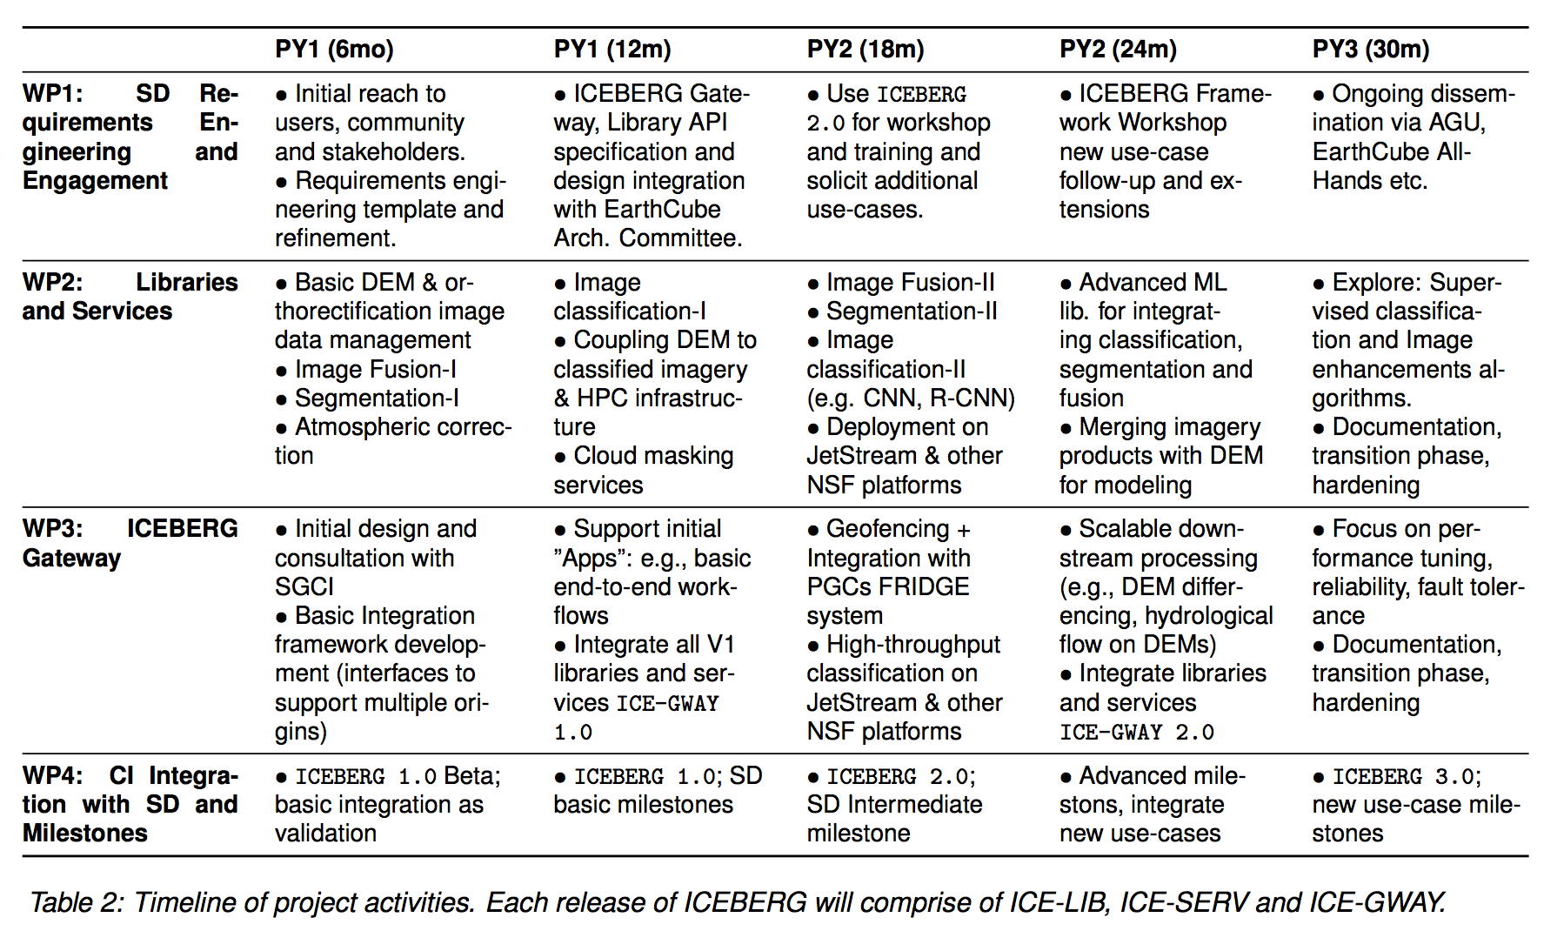
Project Plan: Initial Milestones + Timeline
Final decision on WP3 Gateway will depend upon requirements, personnel and support from Science Gateways Institute.

Slide 19
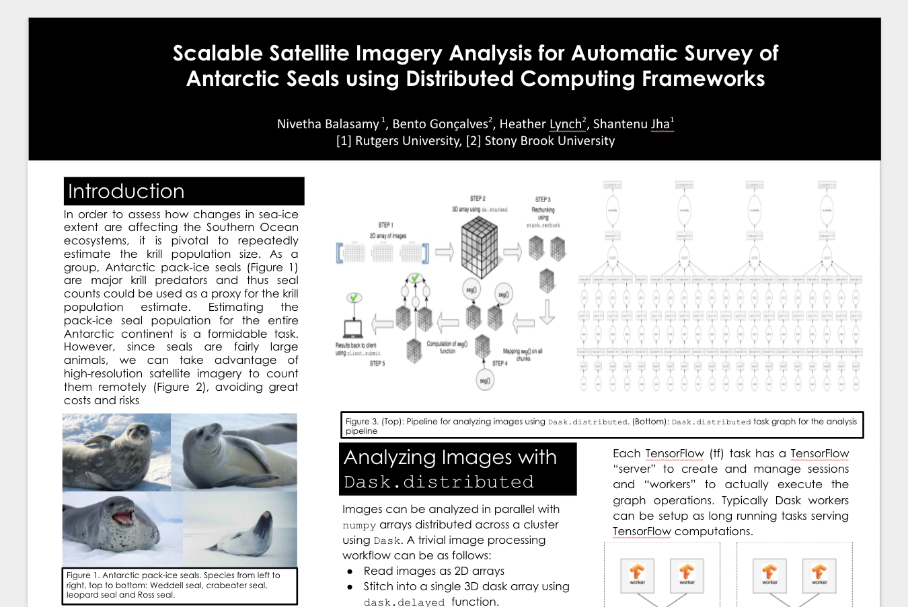
Ask not what ICEBERG can do for TAC...
What data capabilities are being developed within EAC that ICEBERG can leverage?
Other EC Projects: Pairwise partnership, or is there something that EC-TAC can facilitate?
PanaGeo shows significant synergy: e.g., Dask, XArray etc.
ASSET ?
Never to soon to think about sustainability of ICEBERG!
Keep novel software footprint small
Reuse and extend
…
Engaging EC community beyond core set of SD

Slide 20
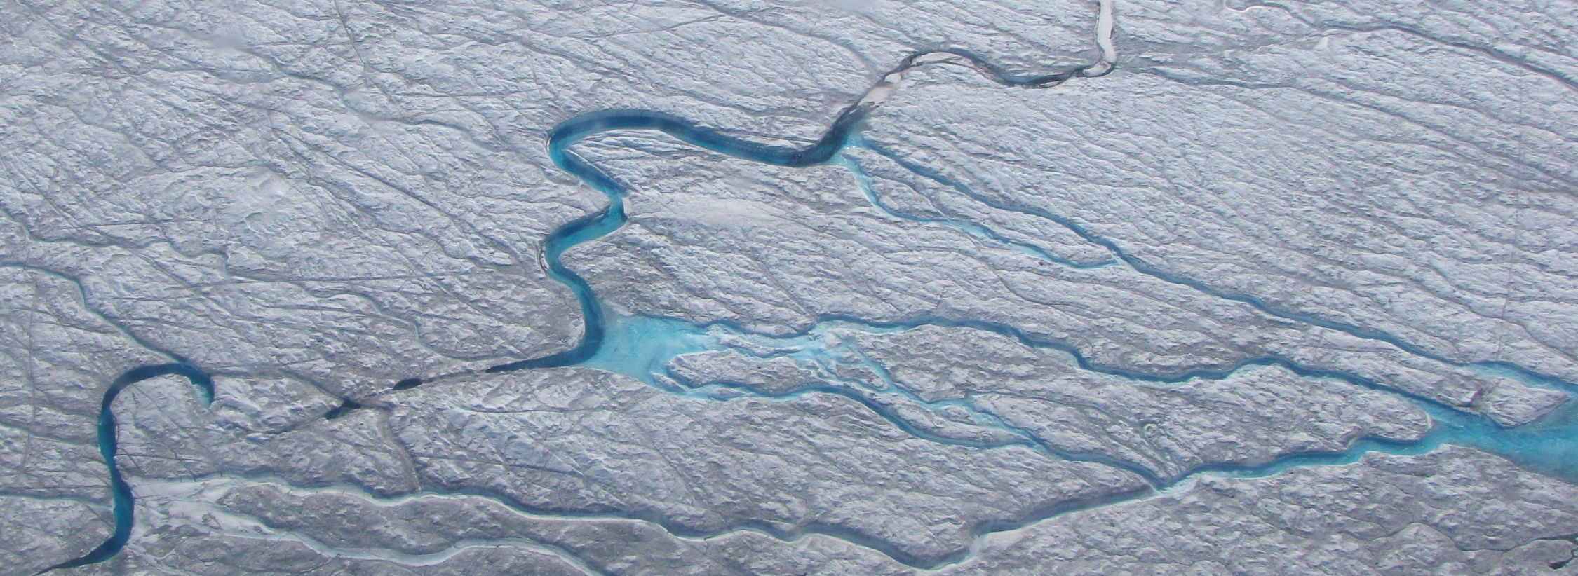
For more information:
https://iceberg-project.github.io/
Photo: Vena Chu

